Slide 1
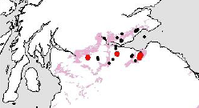
Shale gas resource estimates: methodology and uncertainties
Prof. Zoe Shipton
Department of Civil and Environmental Engineering
University of Strathclyde

Slide 2
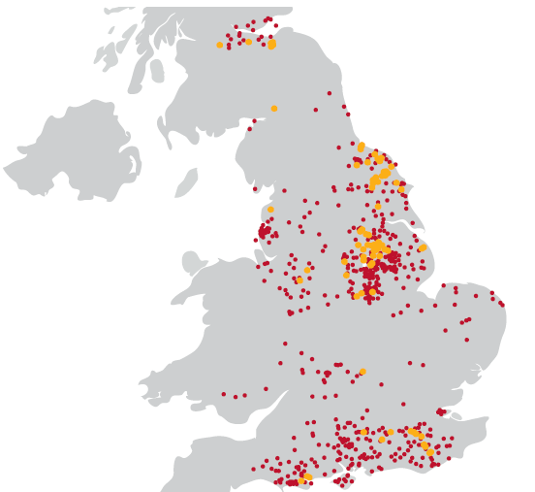
Unconventional gas
commercial quantities of methane (± ethane, hydrogen, carbon monoxide etc) obtained by means other than traditional methods of drilling into naturally permeable rocks containing free gas phases
extraction of ‘conventional gas’ often also involves reservoir stimulation by fracking, pumping, ‘flooding’ (with air, CO₂, or even fire) etc
the distinction between ‘conventional’ and ‘unconventional’ thus largely boils down to geology: conventional reservoirs are typically sandstones (and sometimes other hard rocks) whereas unconventional gas targets include rocks traditionally regarded as ‘source rocks’ rather than reservoir rocks: shale, coal etc
Conventional oil and gas wells, onshore UK
= wells drilled
= wells from which gas has been produced

Slide 3
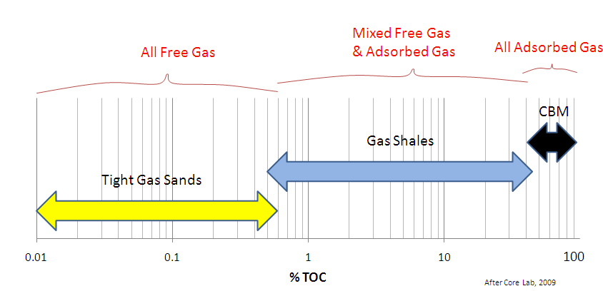
Tight gas: relatively impermeable rock, limestone or sandstone
Shale gas: gas trapped in fine‐grained sedimentary rock -shale
Coal‐bed methane (CBM): gas trapped in coal seams, adsorbed in the solid matrix of the coal
https://www.og.decc.gov.uk/UKpromote/onshore_paper/UK_onshore_shalegas.pdf

Slide 4
Unconventional gas
Fossil sources of unconventional gas:
Shale gas
Coalbed methane
Underground coal gasification
Renewable sources of unconventional gas:
anaerobic digestion
biomass gasification
hydrogen from electrolysis of water

Slide 5
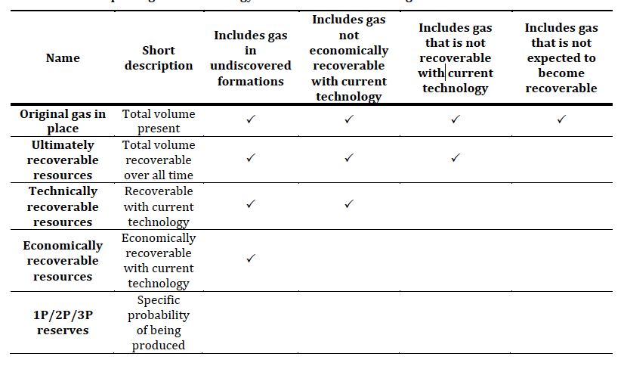
Reserves vs resource
Pearson et al (2012) Unconventional Gas: Potential Energy Market Impacts in the European Union. EU JRC Scientific and Policy Reports
http://ec.europa.eu/dgs/jrc/downloads/jrc_report_2012_09_unconventional_gas.pdf
Notes:
Resource: total gas underground = gas in place
Technically (TRR) > economically recoverable resources: amount of gas that could be extracted, taking into account technical or economic factors
Reserves (possible, probable and proven): the amount of gas that can be extracted, taking into account the cost, practicalities and social and economic factors, will change over time.

Slide 6
Recovery factor
Amount of hydrocarbon left in the formation
e.g. collapse of pore network,
compartmentalisation, “attic oil”
Conventional hydrocarbons 70-80%
Shale gas 15-35%
In practice the only way to determine the recovery factor is to produce

Slide 7
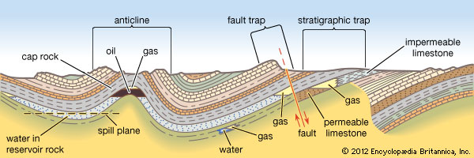
Discovered vs undiscovered
Conventional petroleum relies on a petroleum system
Shale gas: drilling into the shale will usually yield gas (no migration), technical and economic feasibility unknown until tried

Slide 8
SPE Petroleum Resources Management system
Discovered shale gas resources =
Existence of significant moveable hydrocarbons (well tests, core, log data)
Evidence that similar areas support commercial gas production
Society of Petroleum Engineers (2011) 'Guidelines for Application of The Petroleum Resources Management System. http://www.spe.org/industry/docs/PRMS_Guidelines_Nov2011.pdf

Slide 9
“If and when the Government does decide to issue estimates of UK shale gas resources it should set a good example and ensure that it is explicit about which definition it is using.
“the definition which is most relevant to the general public … is recoverable resources”
“The Government should clearly communicate the uncertainty inherent in [the] figures”
From Committee on Energy and Climate Change 7th report – The impact of shale gas on energy markets
http://www.publications.parliament.uk/pa/cm201213/cmselect/cmenergy/785/78502.htm

Slide 10
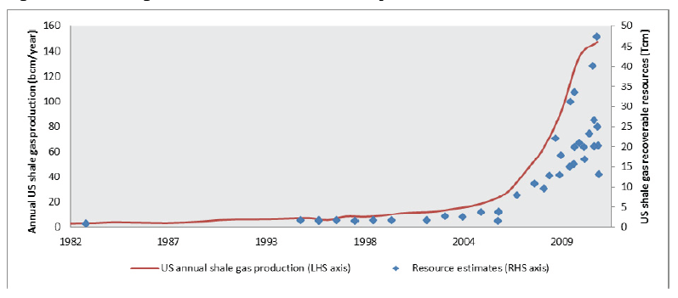
Very large variability…
Even when production is mature!
Pearson et al (2012)

Slide 11
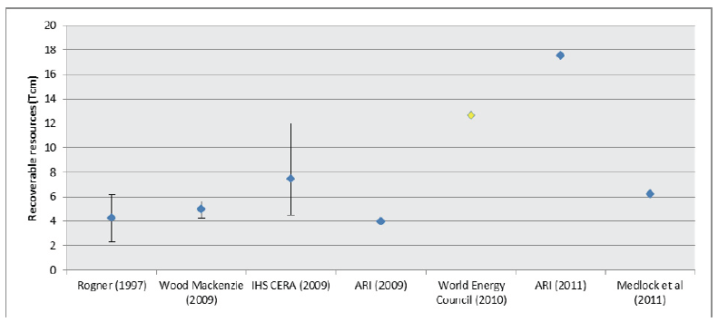
TRR shale gas estimates in Europe
Pearson et al (2012)
original assessment Poland's TRR = 5.3 tcm (187.2 tcf)
reduced to 0.35-0.77 tcm (12.36-27.19 tcf)

Slide 12
Technically recoverable resource | Min (trillion cubic meters, tcm) | Min (trillion cubic feet, tcf) | Max (tcm) | Max (tcf
Global | 118 | 6639.2 | 208 | 7345.5
European | 2.3 | 81.2 | 19.8 | 699.2
UK | 0.15 | 5.29 | 1.15 | 40.61
One trillion cubic metres (35.32 tcf) is equivalent to ~10 years of UK gas consumption at current demand levels
Assuming UK total demand is approximately 1,000,000 GWh, equivalent to ~10tcm.
Figures from Committee on Energy and Climate Change 7th report – The impact of shale gas on energy markets http://www.publications.parliament.uk/pa/cm201213/cmselect/cmenergy/785/78502.htm

Slide 13
UK estimates - methodology
The unconventional hydrocarbon rescources of Britain’s onshore basins – Shale Gas
https://www.og.decc.gov.uk/UKpromote/onshore_paper/UK_onshore_shalegas.pdf
Resource estimates made against analogues for producing shale gas plays in the US
Used area of outcrop of the geological units
UK US
Jurassic Antrim Shale (47mmcf/km2)
Carboniferous (U. Bowland) Barnett Shale (268 mmcf/km2)
New BGS estimates within a matter of weeks….

Slide 14
UK estimates - CBM
BGS estimate total UK CBM resource 2,900 bcm
coals with the right depth, thickness, gas content and adequate separation from underground mine workings
Recovery factors of 1% to 30-40% (US)
10% = 290 bcm
The unconventional hydrocarbon rescources of Britain’s onshore basins – Coal Bed methane (CBM)
https://www.og.decc.gov.uk/UKpromote/onshore_paper/Promote_UK_CBM.pdf

Slide 15
“…it is impossible to determine reliable estimates of shale gas in the UK … until we have practical production experience.”
“ …the Government should encourage exploratory shale gas operations … to improve current estimates, providing that public concern over environmental impacts is recognised and taken into account.”
“It should require shale gas companies to share their gas content and production figures with relevant research bodies (subject to commercial confidentiality)”
Committee on Energy and Climate Change 7th report

Slide 16
Where is the uncertainty?
Very little previous work on shales (not cored)
Heterogeneous rock types (sweet spots)
Geological model (outcrop area vs rock volume – new BGS estimates)
Assumed recovery factor – varies from 15-40%
Decline curve analysis
Technological advances may be significant

Slide 17
“Sweet spots”
Localised area with higher recovery factor
rock strength
horizontal stresses, stress anisotropy
total organic carbon
thermal maturity
natural fractures/faults
e.g. faulting in the Woodford
karst collapse chimneys in the Barnett
natural fracturing in the Marcellus
Notes:
Traditional critical reservoir characteristics thickness, matrix permeability, porosity and oil/gas saturation also important
faulting in the Woodford,
karst collapse chimneys in the Barnett,
natural fracturing in the Marcellus

Slide 18
Interpreting uncertain geological data
Geological data inherently under-constrained and therefore uncertain
Bond et al. (2007, 2012)
445 interpretations of a seismic image: 21% “correct”
184 self- defined experts: 35% correct
1937-88
1991
1993
1993
1995
e.g. Changes in geological interpretation at Sellafield from 1937 to 1995 (investigations stopped 1997)
All models provided by Midland Valley Exploration (MVE)

Slide 19
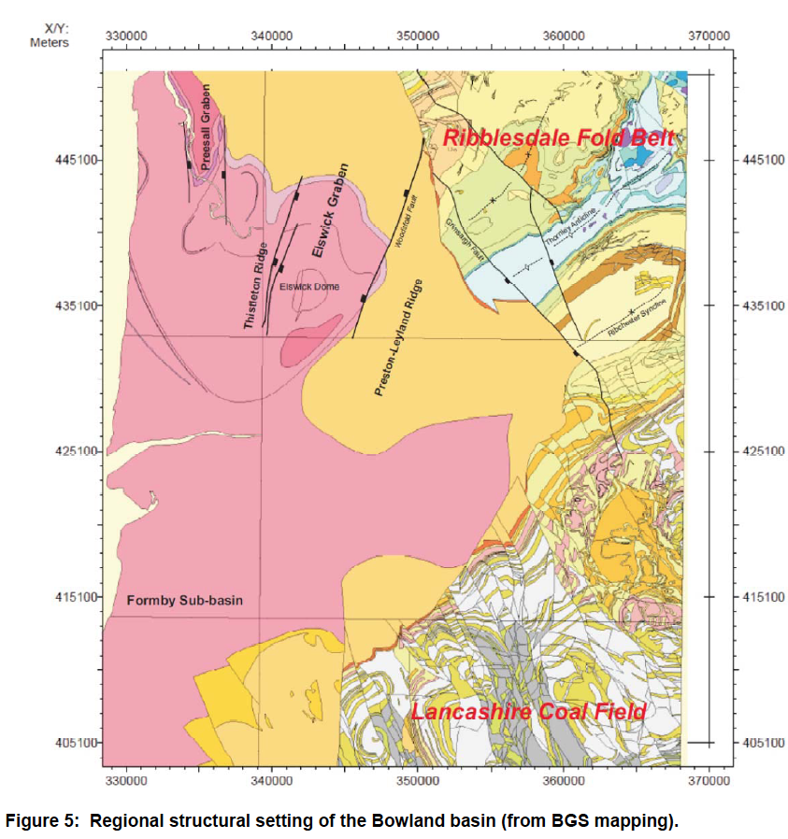
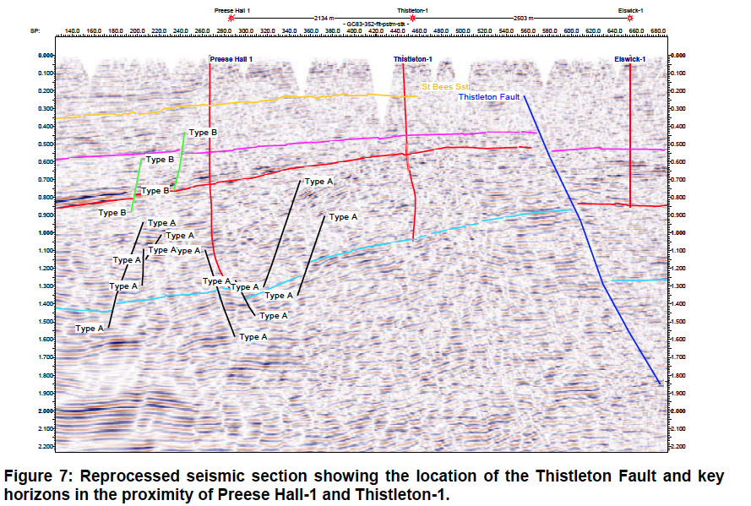
Geological concept uncertainty and risk
US basins largely “undeformed”
UK basins significantly folded and faulted
Preece Hall earthquakes – more later from Paul
vchdth

Slide 20
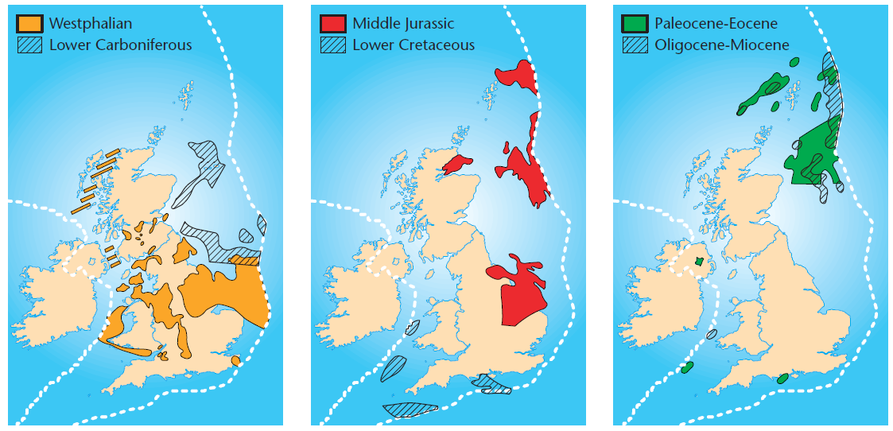
Offshore unconventional gas?
No current offshore production globally
Technically possible
Publically more acceptable?
Ideally in next 10-15 years before platforms decommissioned
Source: Knight et al. (1996) Geol. Soc. Special Publ. 109: 43-57

Slide 21
Shale Gas vs Shale Oil and Oil Shale
Shale oil "How much money you can make out of the liquids that you are producing during the shale gas operations. If the shale gas is fairly wet then, even though the dry gas you are selling is not earning you any money, you will earn a lot of money from producing the liquids and that is the key to the continuation of the revolution in the US at the moment.” (Para 10. ECC report)
Oil shales – possible to retort in situ
West Lothian oil shale fm. Very shallow - so environmental no no.

Slide 22
Thank you!

