Slide 1
Household energy efficiency programme evaluation: does it tell us what we need to know?
Dr Joanne Wade
CXC
19-05-15

Slide 2
The question
What is the evidence that energy efficiency programmes targeted at the household sector have delivered real energy savings?
Conceptual and definitional issues
Strengths and weaknesses of different methodological approaches
Identify robust evaluations
Range of energy savings likely
Recommendations on the future design and focus of programme evaluation

Slide 3
Methodology
Expert group:
Ute Collier; Committee on Climate Change
Hunter Danskin; DECC
Malcolm Keay; Oxford Institute for Energy Studies
Michelle Shipworth, UCL Energy Institute
Steve Sorrell; CIED, Univ. of Sussex
Peer reviewers:
Wolfgang Eichhammer; Fraunhofer Institute
Ed Vine; formerly Lawrence Berkeley Lab.
Scoping note, agreed by expert group
Review literature on good practice evaluation
Search key databases and conferences for literature
Develop framework to characterise and analyse literature
Review literature and select key evidence
Use this to answer the question!
Draft report review, expert group and peers
Publication and dissemination

Slide 4
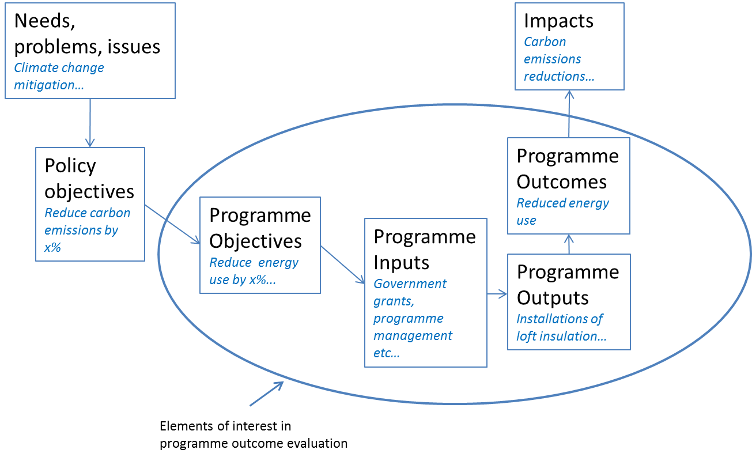
Scope of programme evaluation

Slide 5
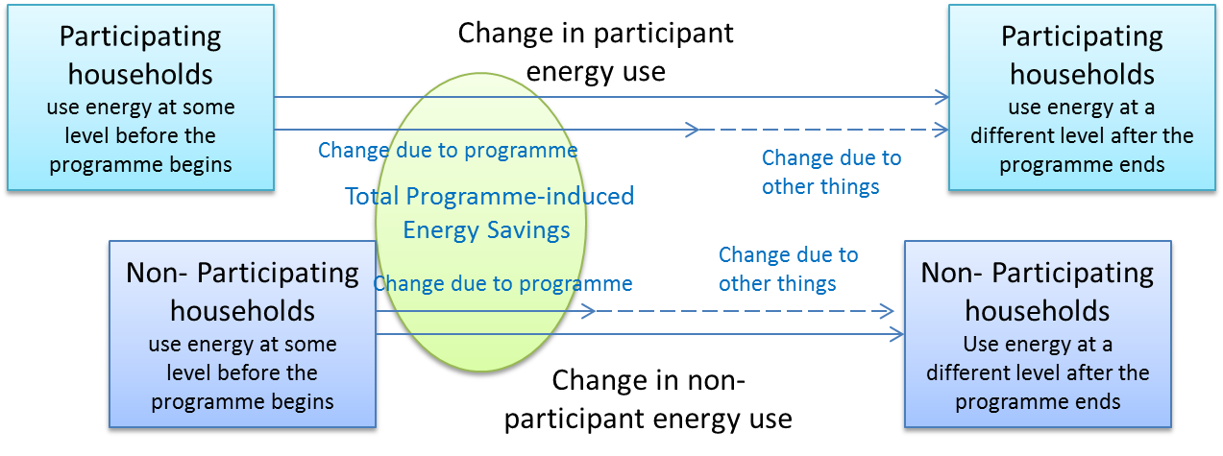
The evaluation problem

Slide 6
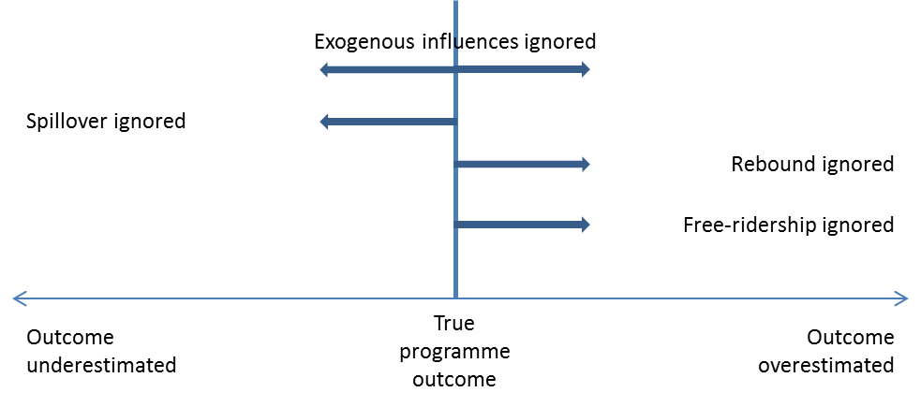
Defining the counterfactual

Slide 7
Evaluation in practice
Constraints for evaluators
Data issues
Implementing Randomised Control Trials
Transferability of findings
Resourcing an evaluation

Slide 8
Results - theory

Slide 9
Results – practical use of methods
RCT = most accurate for well defined single interventions on clearly defined population
Engineering estimate = least accurate BUT may well be ‘good enough’, especially for large programmes
In between are the range of quasi-experimental approaches, each with strengths and weaknesses

Slide 10
Assessing the evidence
What evaluation methods are used?
Does the evaluation demonstrate an understanding of how the programme is likely to affect energy use, and hence seek to collect and use appropriate data?
Is the scale and nature of the evaluation appropriate for the programme size and stage, and level of existing knowledge about outcomes?
Is the choice of evaluation method appropriate for the available data?
Are the limitations of the evaluation acknowledged and, where possible, adjusted for?

Slide 11
Results - The evidence base
Widely spread: energy efficiency and evaluation conferences and 20 different journals
Dominated by evaluation of energy company schemes, for regulatory purposes
Significant lack of detail about evaluation methods – difficult to judge quality
NB this is the peer-reviewed evidence only; there is significant information in grey literature…

Slide 12
Addressing the evaluation challenge
Well tackled:
Exogenous influences
Participant spillover
Direct rebound
Less well tackled:
Free-ridership
Self selection
Hardly addressed:
Indirect rebound and non-participant spillover

Slide 13
What we seem to know
Minimum efficiency standards for buildings, appliance market transformation activities and investment programmes all reduce energy use; but by less than ex ante estimates would suggest.
Savings from these types of programme in the order of 10% of total household energy use for participant households
Average effects of feedback programmes 1-5% of participant household energy use
Large range around this average at the individual household level

Slide 14
What we seem not to know
Likely magnitude of effects like spillover and free-ridership.
Outcomes of information / advice other than through feedback; of community-led programmes; of innovative finance
‘Reach’ of different types of programme
Wider economic impacts

Slide 15
Recommendations: evaluation research
Greater understanding of importance of effects like non-participant spillover.
Economy-wide impacts of packages of energy efficiency programmes
Outcomes of community-led, behaviour change and innovative finance programmes
Analysis of the grey literature and reports in languages other than English

Slide 16
Recommendations: evaluation practice
Methods: greater use of Randomised Control Trials and quasi-experimental alternatives where appropriate, together with more use of multiple evaluation methods to cross-check results
Variability: deeper exploration of the variation in effects between different households, making innovative use of the large datasets (e.g. from building energy certification and smart metering) that are now becoming available; understanding which households are reached by which approaches
Shared learning: greater exposure of evaluation results to discussion in the peer-reviewed literature
Usefulness: presenting evaluation results in such a way that cross-programme comparison is easier (e.g. offering percentage savings figures as well as kWh).

Slide 17
Recommendations: policy
Continue support for energy efficiency policies and programmes – these are likely to remain cost-effective.
Well established approaches – standards and incentives should form the core in the short term
New approaches need to be piloted and evaluated before any commitment to replacing existing approaches
Policymakers need to respond to the significant opportunity to learn from experience in other countries and jurisdictions

Slide 18
UK Energy Research Centre
+44 (0)20 7594 1574
www.ukerc.ac.uk
full report to be published soon :
http://www.ukerc.ac.uk/programmes/technology-and-policy-assessment/energy-efficiency-evaluation.html
joanne.wade09@gmail.com

