Slide 1
Climate Change Agriculture and Food Security
Richard Tiffin

Slide 2
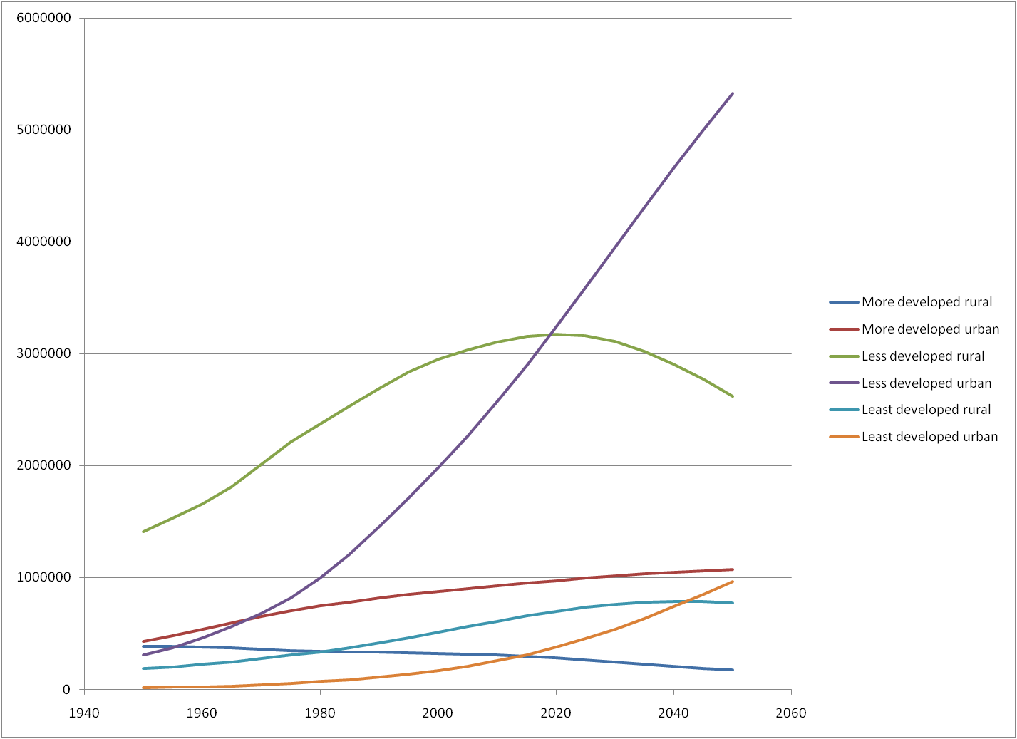
Population Growth

Slide 3
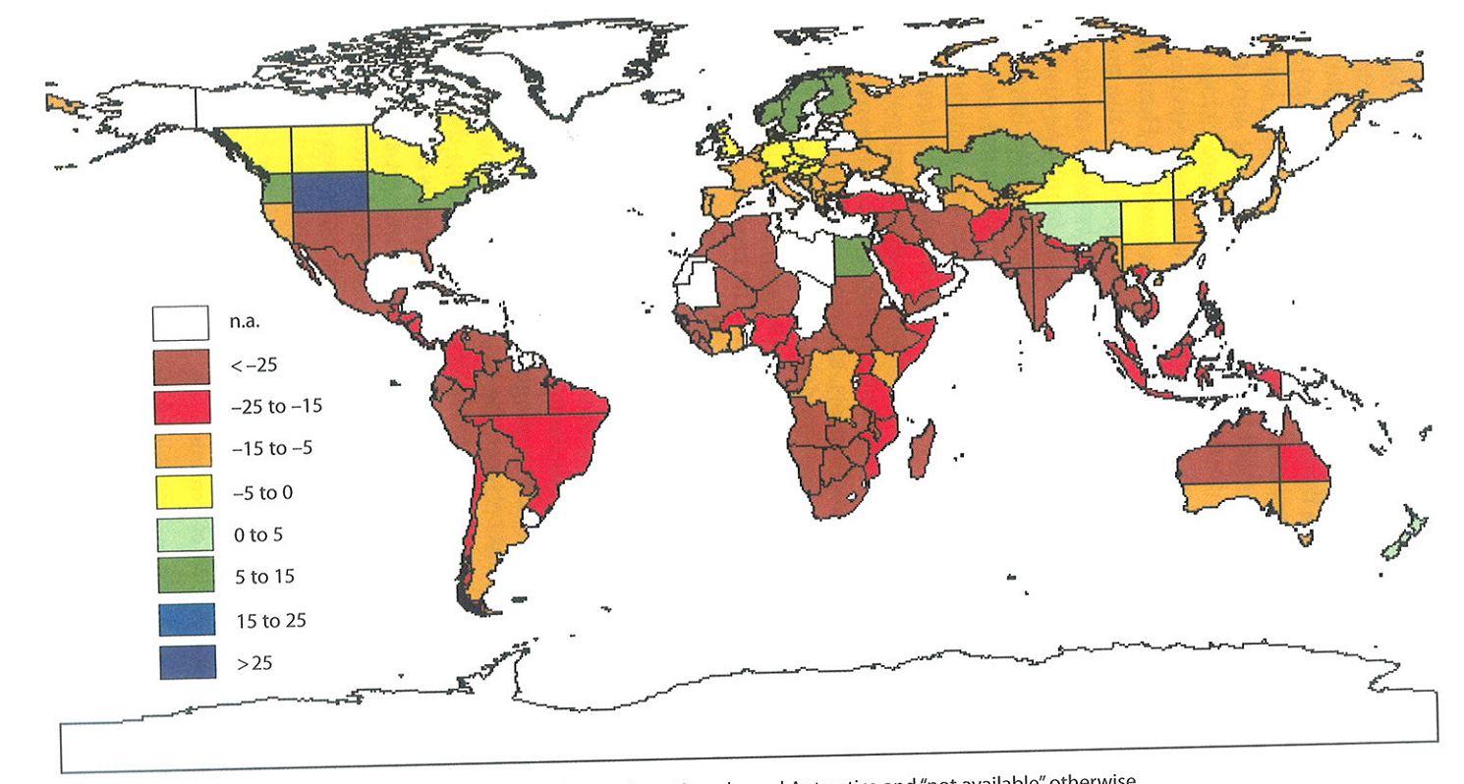
Impacts of Climate Change on Agricultural Productivity
Source: Klime (2007)

Slide 4
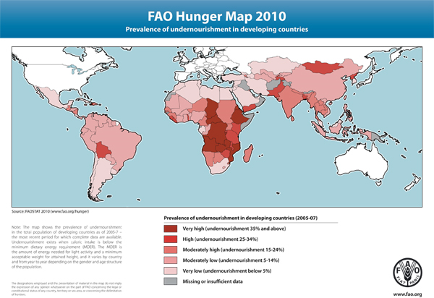
Global Hunger
Notes:
Population growth coupled with climate change, and increased pressure for resources lead to the concern that existing patterns of hunger will be exacerbated.

Slide 5
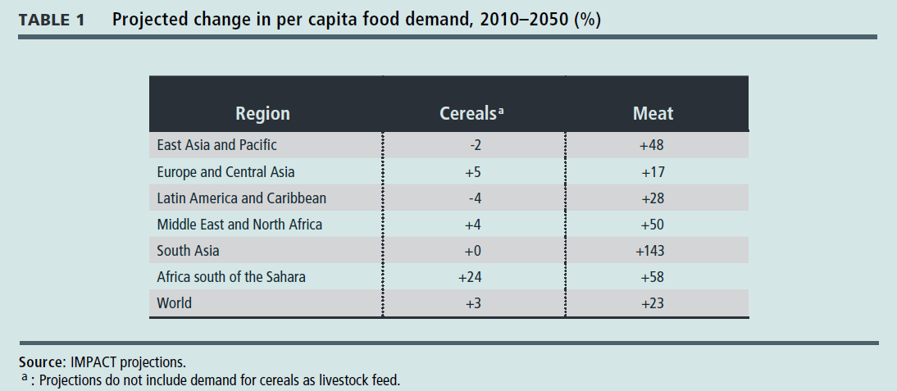
Changes in Demand
IFPRI: Global Food Policy Report

Slide 6
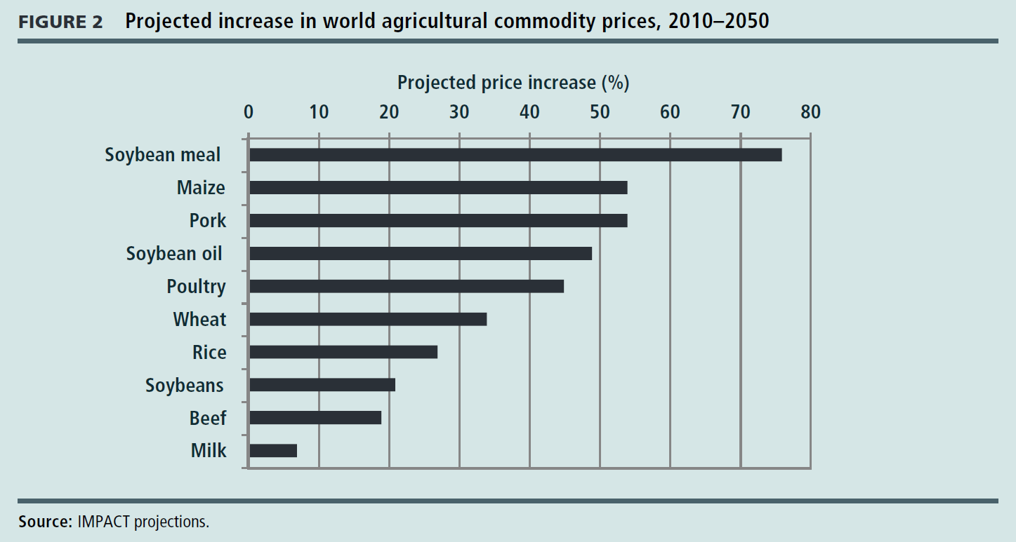
Change in prices
IFPRI: Global Food Policy Report

Slide 7
International Commodity and UK Food Prices

Slide 8
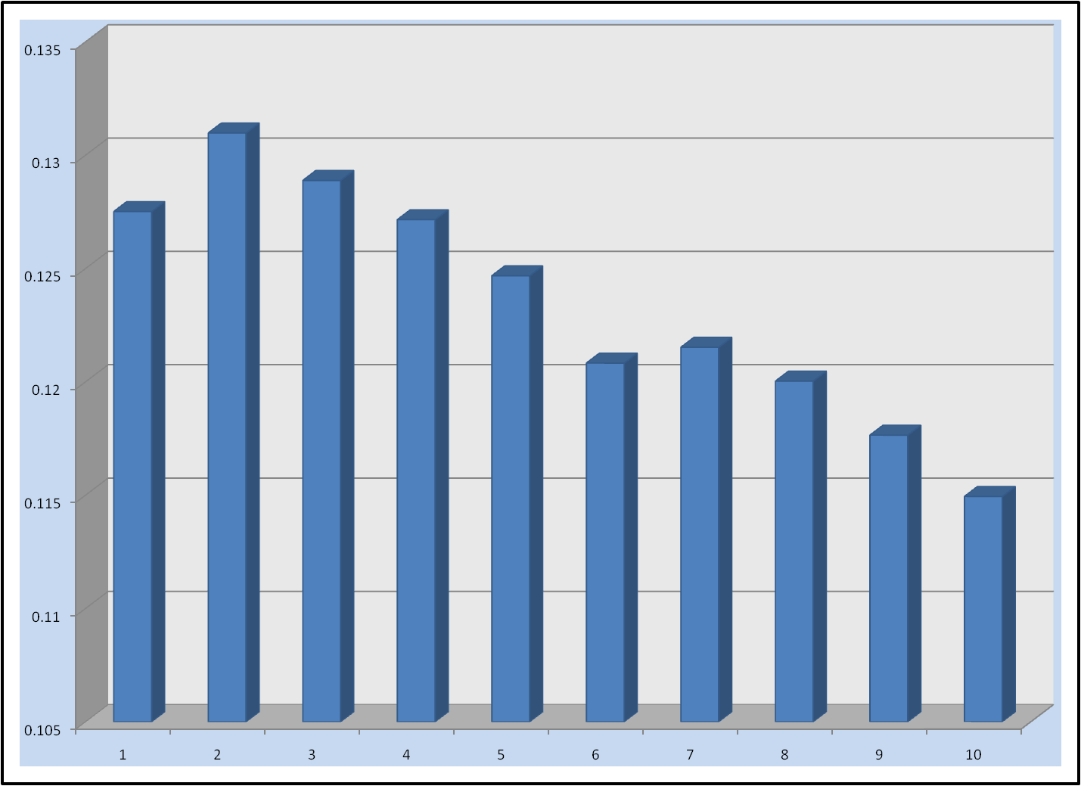
Inflation by household income decile January 2006-December 2009
Notes:
And here I want to emphasise the impacts of this type of price change across households of differing income levels.
This slide shows the inflation rate experienced by different households according to their income level accounting for the fact that food expenditure is much larger proportion of household expenditure in low income households. We see that in the second lowest income decile, the inflation rate was over 13% in the period analysed and in the highest it was below 11.5%.

Slide 9
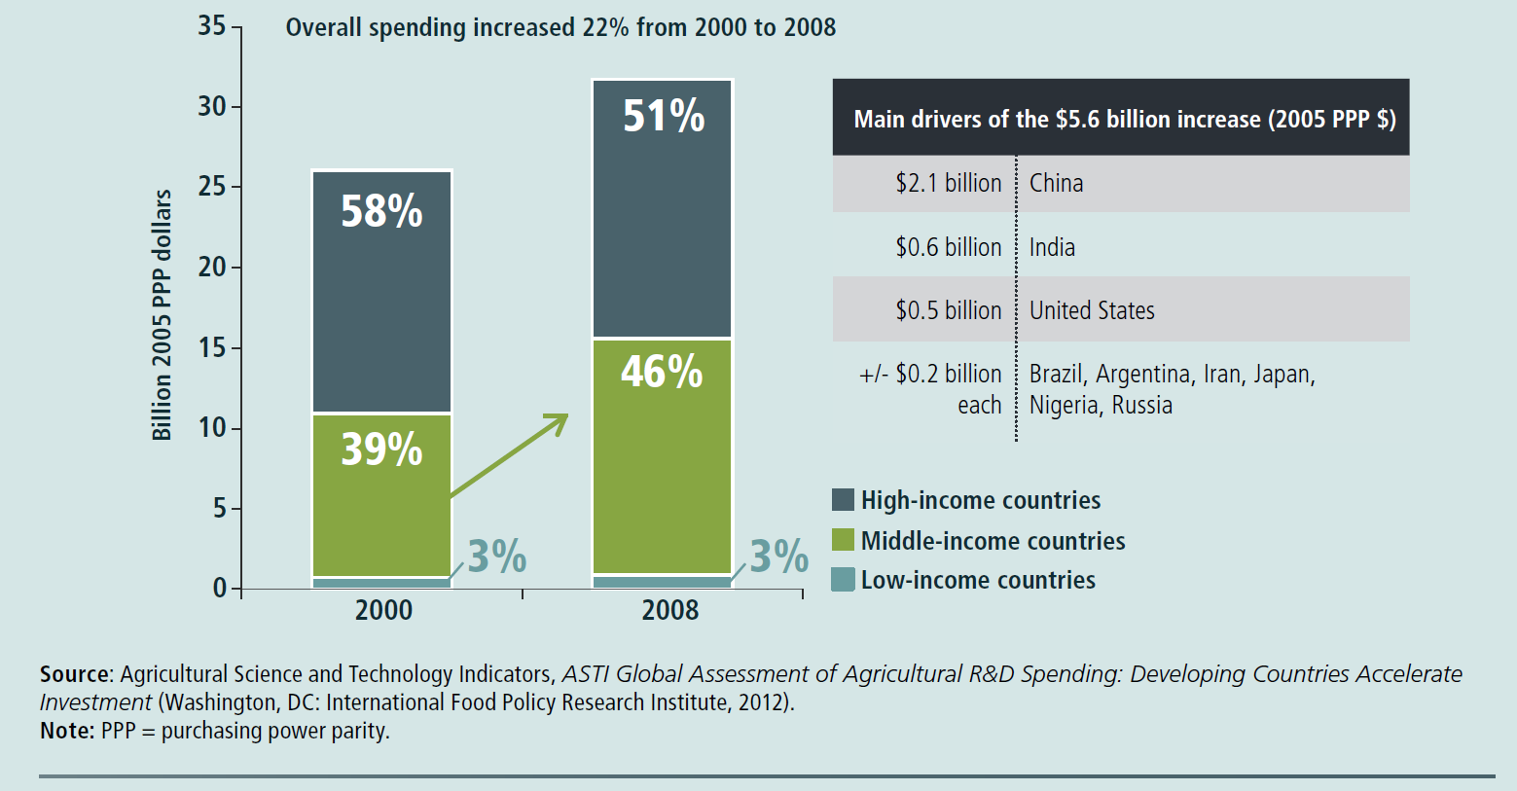
Global Public R & D expenditure

Slide 10
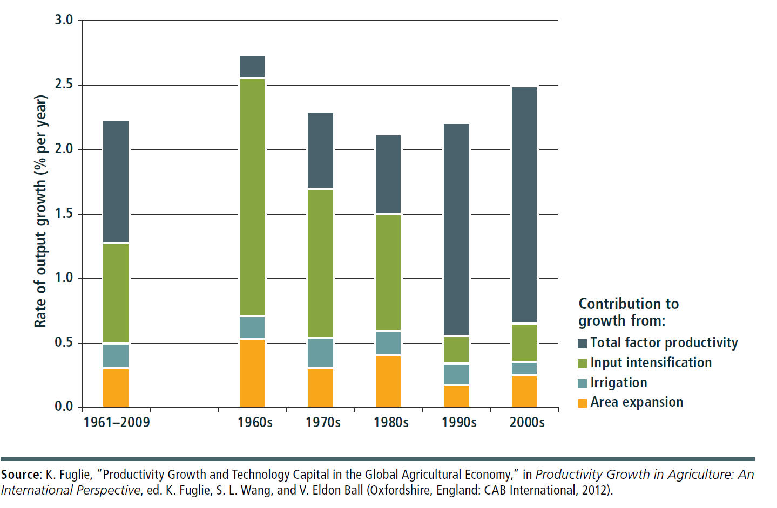
Sources of output growth

Slide 11
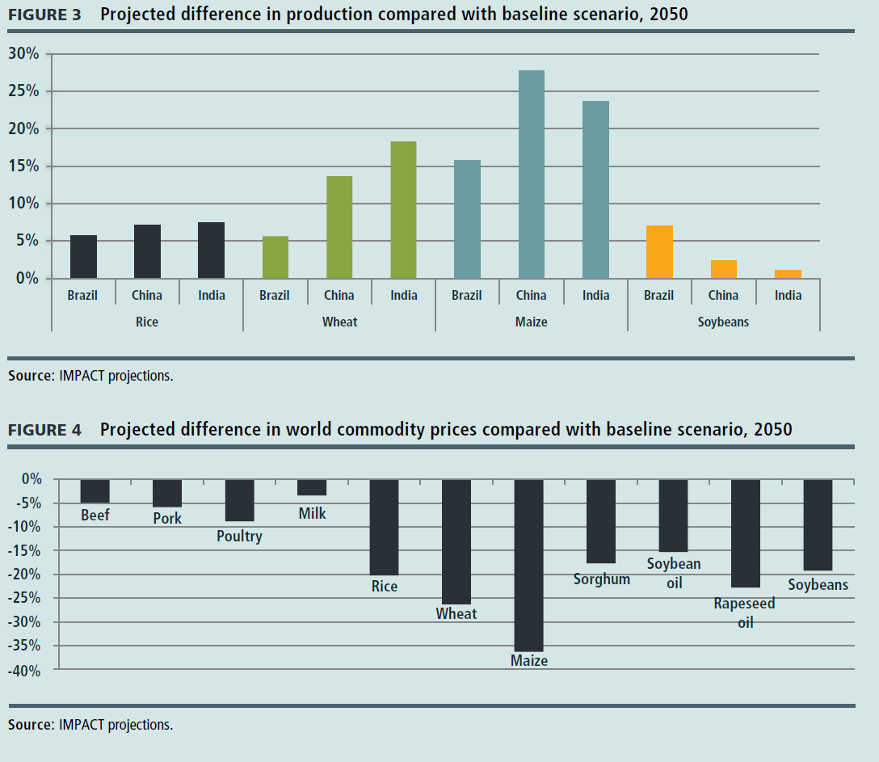
Impacts of Productivity Growth (2050)
Notes:
Productivity increased to keep cereal prices at the same level over the period.
Maize production needs to rise by 16-28%, wheat by 6-18%.

Slide 12
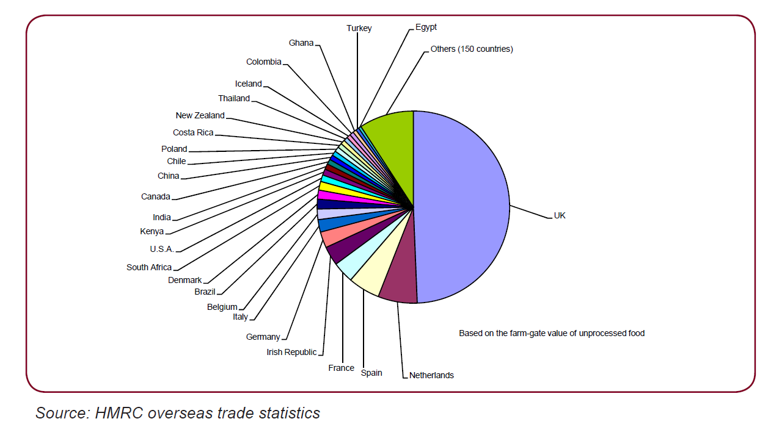
Vulnerability of UK Supply Chains? Sources of food consumed in UK
Notes:
In terms of where these imports come from
Of the roughly 50% of raw equivalent we import most comes from Europe.
But we depend on only 25 countries for the bulk of our imports – which in some peoples minds gives rise to some security of supply concerns.

Slide 13
The livestock in the room.
Two thirds of EU land used for livestock.
75% protein rich feed is imported.
Globally around 30% of biodiversity loss is attributed to livestock production.
Around 10% of GHG emissions from Agriculture.
Red Meat, Saturated Fat and Human Health.
Animal Welfare.
Over-exploitation of fisheries.

Slide 14
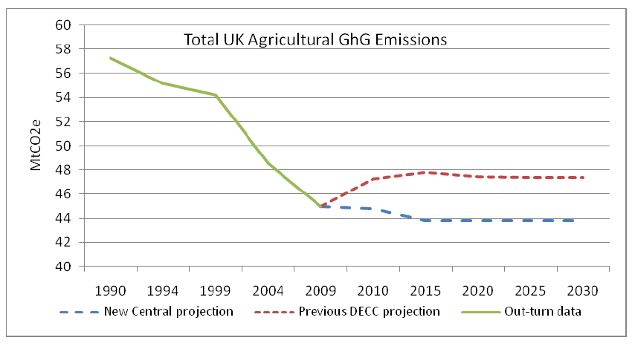
FAPRI Defra Forecasts (baseline)
Changes in Production 2010-1019
Beef | -6.3%
Sheep | -4.9%
Pork | 24.2%
Poultry | 0.5%
Milk | -0.6%
Wheat | 2.7%
Barley | -0.2%

Slide 15
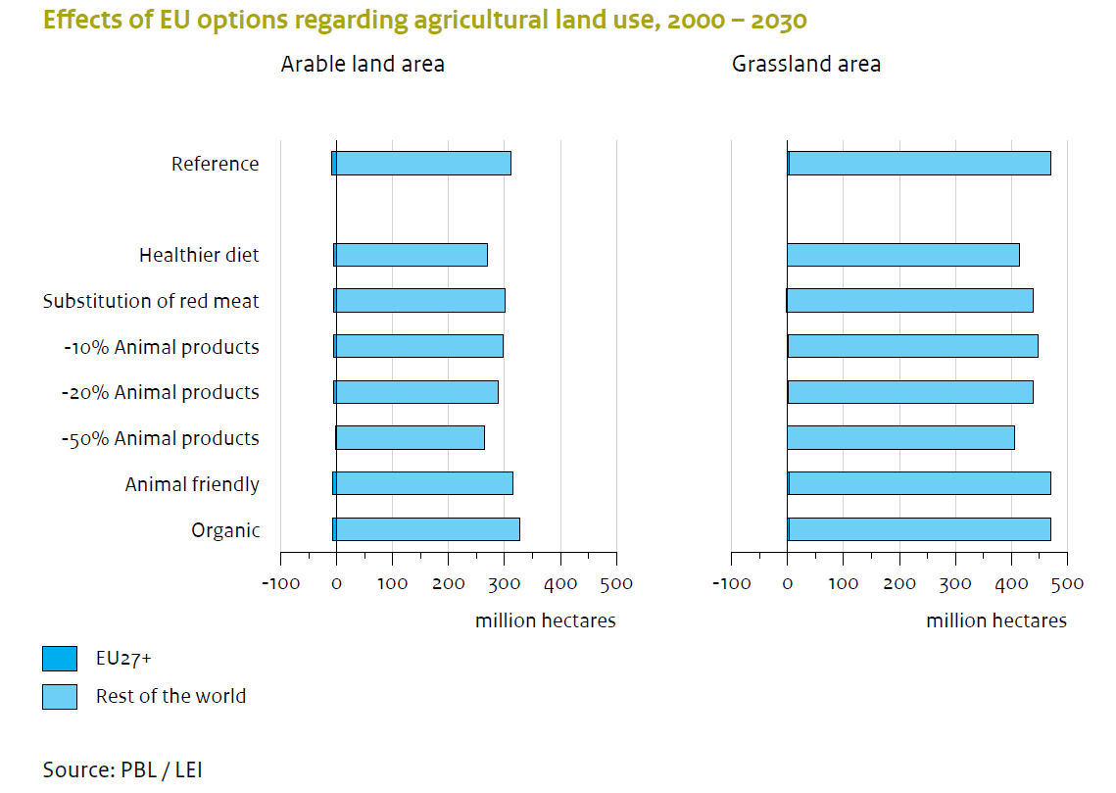
Think globally

Slide 16
Conclusions
Consequences of increased food scarcity mediated to UK food consumers (and producers) through price.
May lead to food insecurity for some parts of the population.
Project price increases are greatest for cereal and protein crops.
These can be ameliorated by substantial increases in productivity.
There is a need for debate around the role of market and policy in the Protein puzzle.

