Slide 1
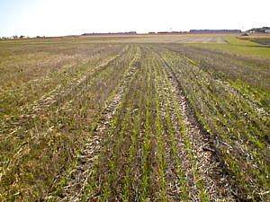


What are the key issues around land use & what are the trade-offs between food security and GHG mitigation objectives on the land?
Pete Smith
Royal Society-Wolfson Professor of Soils & Global Change, FSB, FRSE,
Theme Leader for Environment & Food Security
& Science Director of Scotland’s ClimateXChange
Institute of Biological & Environmental Sciences
School of Biological Sciences,
University of Aberdeen,
Scotland, UK.
E-mail: pete.smith@abdn.ac.uk
ClimateXChange Food Security Meeting, Edinburgh, 19th June 2013

Slide 2
Food Security
“… exists when all people, at all times, have physical and economic access to sufficient, safe, and nutritious food to meet their dietary needs and food preferences for an active and healthy life”.
(definition from the 1996 World Food Summit)

Slide 3
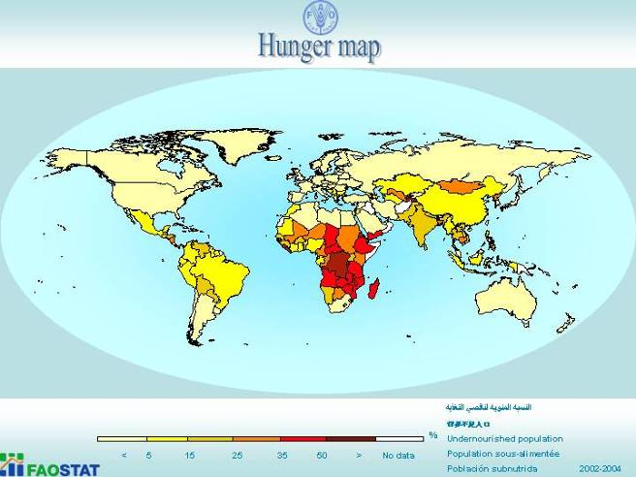
World hunger
Slide from Peter Gregory, EMR

Slide 4
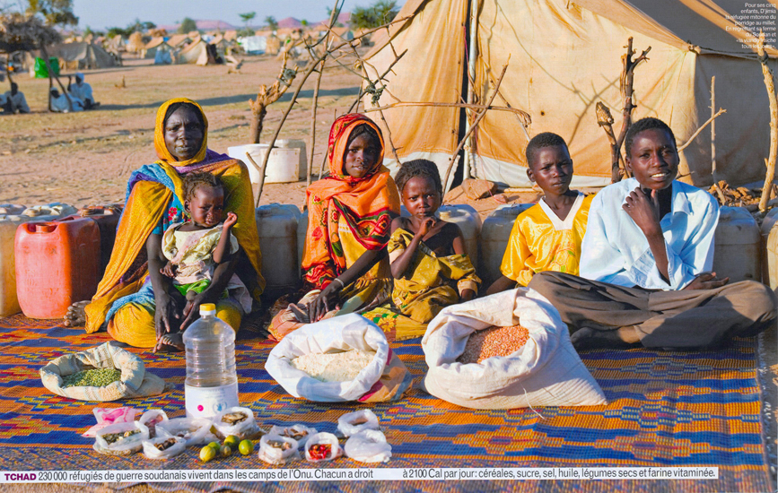
Source: © 2005 PETER MENZEL PHOTOGRAPHY
Notes:
Chad 1week’s food supply
4

Slide 5
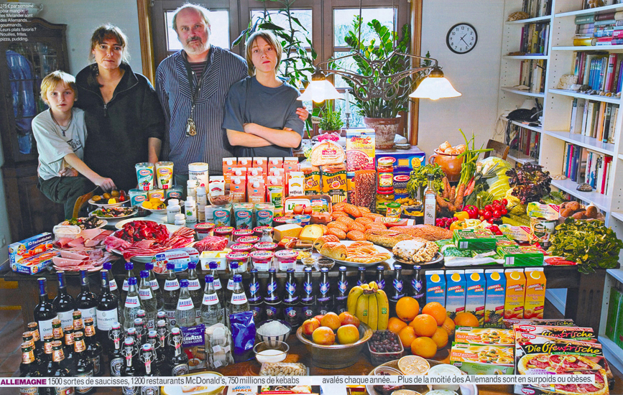
Source: © 2005 PETER MENZEL PHOTOGRAPHY
© 2005 PETER MENZEL PHOTOGRAPHY
2005 PETER MENZEL PHOTOGRAPHY
Notes:
5

Slide 6
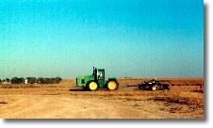
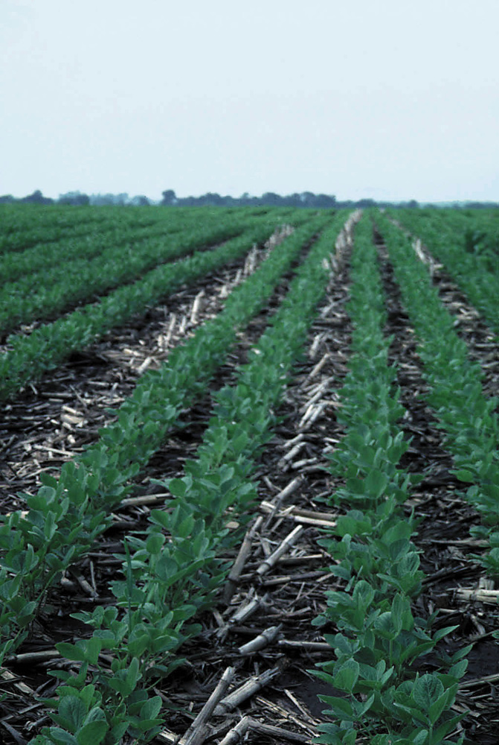
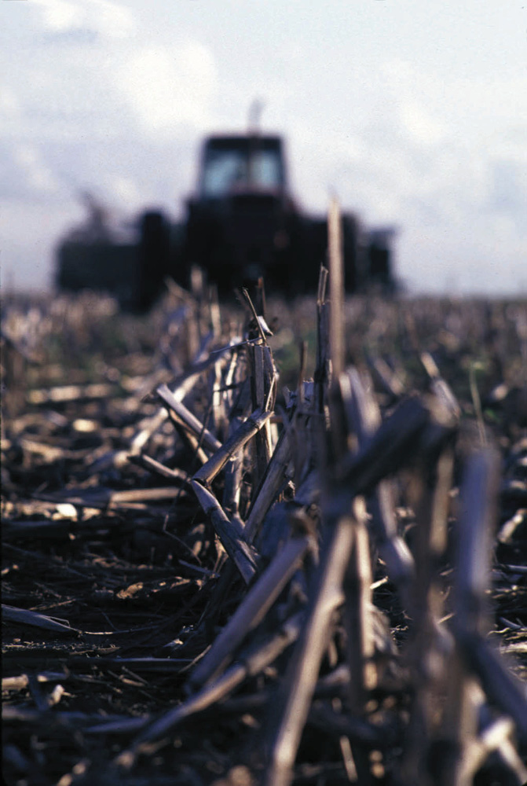
Population growth and dietary change

Slide 7
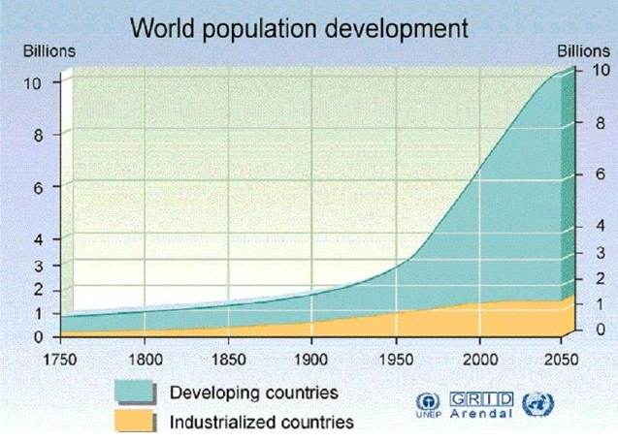
~7 billion in October 2011
~6 billion 1997
~ 3 billion in 1960
Notes:
7
At close to one billion, the number of undernourished people in the world remains unacceptably high in 2010 despite an expected decline – the first in 15 years.
This decline is largely attributable to a more favourable economic environment in 2010 – particularly in developing countries – and the fall in both international and domestic food prices since 2008. The recent increase in food prices, if it persists, will create additional obstacles in the fight to further reduce hunger.
FAO estimates that a total of 925 million people are undernourished in 2010 compared with 1.023 billion in 2009. That is higher than before the food and economic crises of 2008-2009 and higher than the level that existed when world leaders agreed to reduce the number of hungry by half at the World Food Summit in 1996 (Figure above).

Slide 8
Food demand increase
Developing country demand for livestock products projected to increase greatly over the next 40 years as the wealth gap between developed and developing countries reduces.
Smith et al. (2010)

Slide 9
Productivity challenges for agriculture to 2050
Need to increase per area productivity to avoid spreading agriculture on to other land (disastrous for GHG emissions, biodiversity and a range of other ecosystem services)
Need to reduce inputs per unit product to minimise adverse environmental impacts
Need to cope with future climate change
Smith (2013)

Slide 10
Agricultural GHG mitigation – supply-side measures

Slide 11
Agricultural GHG emissions
Bellarby et al. (2008)

Slide 12
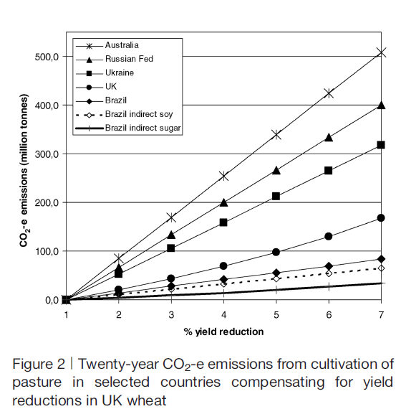
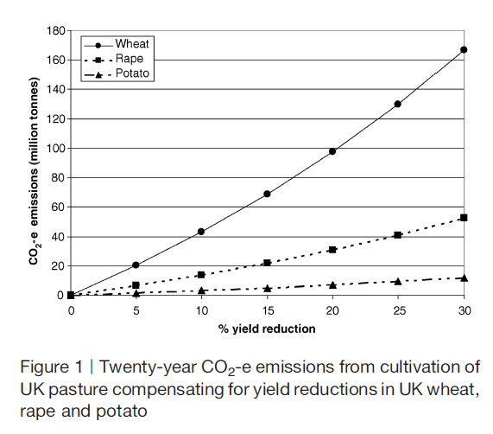
Should be just add less inputs and accept lower yields? – No!
Carlton et al. (2010)

Slide 13
Effect of C price on implementation
Smith et al. (2008)

Slide 14
Global economic mitigation potential for
different sectors at different carbon prices
IPCC WGIII (2007)

Slide 15
Agricultural GHG mitigation – demand-side measures

Slide 16
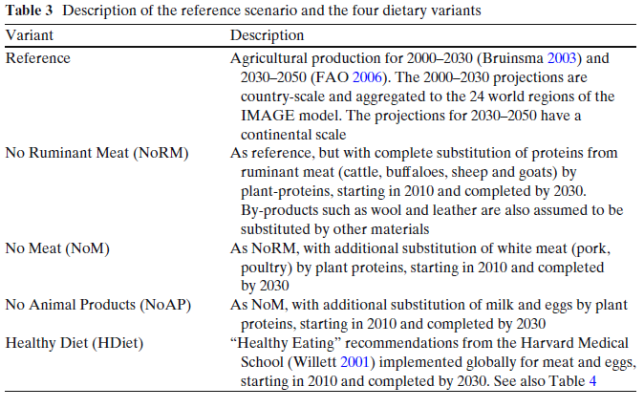
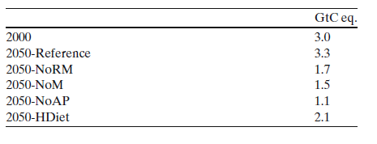
Changed consumption patterns
Fewer animal products in global diet allows everyone to be fed, and land is available for energy and nature conservation
Land based GHG emissions:
Stehfest et al. (2009)

Slide 17
Mitigation potential from changing demand-side measures
Cases | Food crop area | Livestock grazing area | C sink on farm­land* | Afforestation of spare land**,¹ | Bioenergy on spare land**,² | Total mitigation potential | Difference in mitigation from Reference case
 | [Gha] |  | GtCO₂eq.yr⁻¹
Reference | 1.60 | 4.07 | 3.5 | 6.1 | 1.2-9.4 | 4.6-12.9 | 0
Diet change | 1.38 | 3.87 | 3.2 | 11.0 | 2.1-17.0 | 5.3-20.2 | 0.7-7.3
Yield growth | 1.49 | 4.06 | 3.4 | 7.3 | 1.4-11.4 | 4.8-14.8 | 0.2-1.9
Feeding efficiency | 1.53 | 4.04 | 3.4 | 7.2 | 1.4-11-1 | 4.8-14.5 | 0.2-1.6
Waste reduction | 1.50 | 3.82 | 3.3 | 10.1 | 1.9-15.6 | 5.2-18.9 | 0.6-6.0
Combined | 1.21 | 3.58 | 2.9 | 16.5 | 3.2-25.6 | 6.1-28.5 | 1.5-15.6
Smith et al. (2013b)

Slide 18
New estimates since IPCC AR4
Smith et al. (2013a)

Slide 19
Conclusions
Significant, cost-competitive mitigation potential in the AFOLU sector – in agriculture about 90% of this potential is from soil C sequestration
Food supply needs to be increased whilst reducing environmental impact of agriculture
Need to find options and policies that co-deliver improved food security and GHG mitigation – they do exist
Some promising supply-side measures (e.g. efficiency improvements) improve food security and GHG mitigation
Demand-side measures (e.g. changing diets, waste reduction) are under-researched, for food security and for GHG mitigation
More research needed on the economic potential of demand-side measures, and on how to effect behavioural change

Slide 20
Thank you for your attention

